Slide 1
Physical Science
Studying Atoms

Slide 2
Atomic Structure

Slide 3
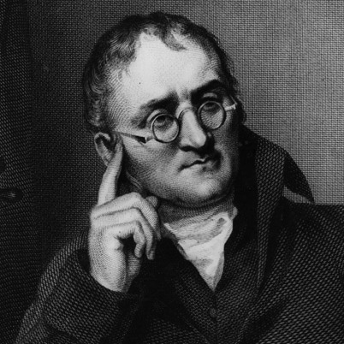
Dalton’s Atomic Theory
Evidence for Atoms – compounds have a fixed composition.
Dalton’s Theory – all matter is made up of individual particles called atoms, which cannot be divided.

Slide 4
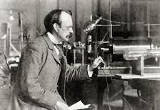
Thomson’s Model of the Atom
Thomson used a sealed glass tube to conduct current. He hypothesized that the charged particles came from inside atoms. Thomson’s experiments provided the first evidence that atoms are made of smaller particles.

Slide 5
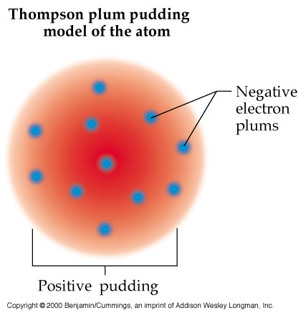
Thomson’s “Plum Pudding” Model
Thomson used the speed of an electron, its angle of deflection and the strength of the current to determine the charge-to-mass ratio of an electron

Slide 6
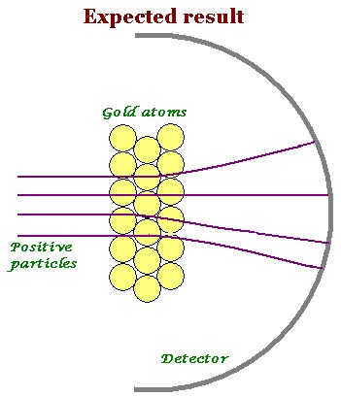
Rutherford’s Atomic Theory
Rutherford discovered uranium emits + particles. If Thomson’s model was correct, if the + particles went through a sheet of gold fold, they would not change path.

Slide 7
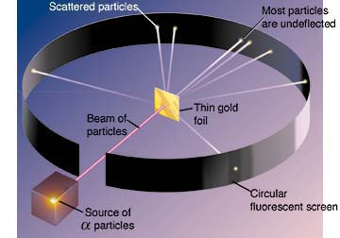
Gold Foil Experiment
The screen around the gold was made of a material that produced a flash of light when struck by + particle – showing the path of the + particle.

Slide 8
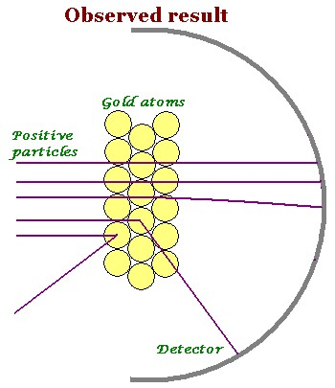
Discovery of the Nucleus
Rutherford concluded the + charge of an atom is not evenly spread. It is concentrated in a central area.

Slide 10
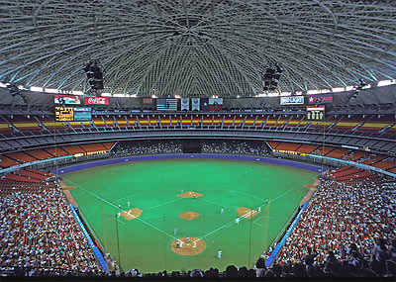

Slide 11
Homework
History of the atom worksheet

