Slide 1
Physical Science
Covalent Bonding

Slide 2
Concept Map (Bubble Map)
Construct a map using the terms:
atoms ionic bonds
molecules polar
ions nonpolar
covalent bond electrons
**The center of the map should have
Chemical Bonding

Slide 3
Covalent Bonds
Covalent bond is a chemical bond in which two atoms share a pair of valence electrons.
The attractions between the shared electrons and the protons in each nucleus hold the atoms together.
Multiple covalent bonds – each bond = 1 pair of shared electrons. Two atoms can share up to 3 pairs of electrons.

Slide 4
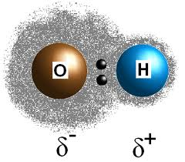
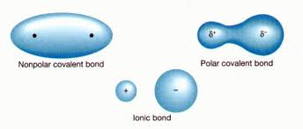
Unequal Sharing of Electrons
Polar covalent bonds – electrons are not shared equally. **the atom with the greater attraction for electrons has a partial negative charge/ the other atom has a partial positive charge.
(denoted by delta: δ⁻ or δ⁺)

Slide 5
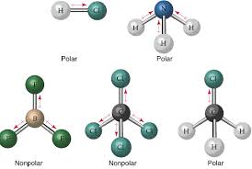
Polar and Nonpolar Molecules
The type of atoms in a molecule and its shape are factors that determine whether a molecule is polar or nonpolar.

Slide 6
Using Models
Use the model to predict whether the molecule will be polar or nonpolar.
Write your answers on the back of the concept map.

Slide 7
Attraction Between Molecules
Attractions between polar molecules are stronger than attractions between nonpolar molecules.
These are intermolecular forces and are not as strong as bonds, but are strong enough to hold things together. This affects evaporation point, boiling point, and surface tension.

Slide 8
Homework
p. 169 1-8

