Slide 1
Physical Science
Work and Machines

Slide 2
What did you learn yesterday?
Work
Power
Energy

Slide 3
Work, Power Quiz
What is the formula for work?
What are the units for work?
What is the formula for power?
What are the units for power?
A 100 newton object is lifted 1 meters. What is the amount of work done?
A 100 newton object is lifted 1 meters in 2 seconds. What is the power?

Slide 4
Work, Power, Energy Quiz
I lifted a 10 kg object 1 meter. What was the amount of work?
I lifted a 10 kg object 1 meter in 2 seconds. What was the power?
A woman carries a 4 kg bag of cat food home from the market. The market is 50 meters from her home. Did she do work in the y-axis when walking home?
A force pushes a 10kg block at an acceleration of 5 meters per second squared. Due to friction, it came to rest in 2 meters. How much work was done?

Slide 5
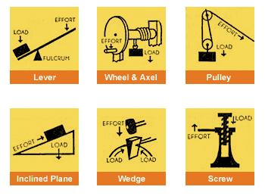
Machines
A machine is a device that changes a force. Machines make work easier to do. They change the size of the force needed, the direction of a force, or the distance over which a force acts.

Slide 6
Machines do one or all of 3 things
Increase force
Increase distance
Change direction of force
Formula for work
Formula for force
Formula for power

Slide 7
Machines
Machines are not 100% efficient. In other words, the work done by a machine is always less than the work done on the machine. (p.419)
https://www.youtube.com/watch?v=yhzMYHiuEC4

Slide 8
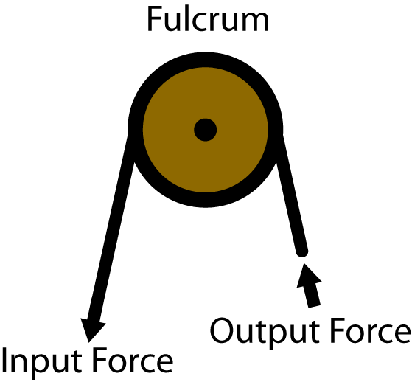
Input
The force you exert on a machine is called the input force.
The distance the input force acts through is known as the input distance.
The work done by the input force acting through the input distance is called the work input.
Work input = Input force * Input distance

Slide 9
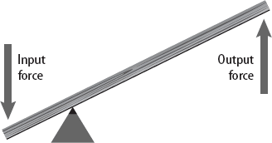
Output
The force that is exerted by a machine is called the output force.
The distance the output force is exerted through is the output distance.
The work output of a machine is the output force multiplied by the output distance.
Work output = output force * output distance

Slide 11
Homework
Read pages 417- 420. Questions 1-84

Slide 12
Remainder of class
Packet of worksheets.
Do not write on them.
Write on a separate sheet.

