Slide 1
Physical Science
Waves

Slide 2
Mechanical Waves (p.500)
A mechanical wave is a disturbance in matter that carries energy from one place to another.
Mechanical waves require matter to travel through. The material through which a wave travels is called a medium.
A mechanical wave is created when a source of energy causes a vibration to travel through a medium.
Three types: Transverse, Longitudinal, Surface

Slide 3
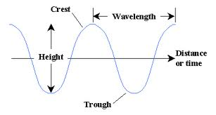
Transverse Waves (p.501)
Trans-across, verse-a plane – moves at right angles to the medium

Slide 4
Longitudinal Waves (p.502)
Compression – an area where particles in a medium are spaced closer together
Rarefaction – an area where particles in a medium are spread out

Slide 5
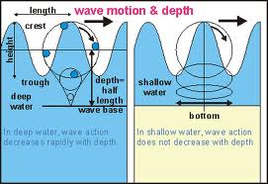
Surface Waves (p.503)
A surface wave is a wave that travels along a surface separating two media.

Slide 6
Homework
Read pages 500-503
Questions 1-7.

