Slide 1
Physical Science
Simple Machines

Slide 2
What did you learn yesterday?
Work
Machines
Force
Power
Work Input
Work Output
Mechanical Advantage
Efficiency

Slide 3
Machines Quiz
A machine is a device that changes one of three things to make work easier to do. Name one of those three things it does to make work easier.
What force will always make machines less than 100% efficient?

Slide 4
Machines Quiz
A lever system lifted a 1000N log 0.5 meters into the air. I applied a force of 800N for 2 meters to make it move that much. What was the efficiency?
A lever system lifted a 1000N log 0.5 meters into the air. I applied a force of 800N for 2 meters to make it move that much. What was the ideal mechanical advantage?
A lever system lifted a 1000N log 0.5 meters into the air. I applied a force of 800N for 2 meters to make it move that much. What was the actual mechanical advantage?

Slide 5
Simple Machines
The six types of simple machines are the lever, the wheel and axle, the inclined plane, the wedge, the screw, and the pulley. (p.427)
These instruments have been used since the beginning of civilization.
Most mechanical devices are combinations of two or more of the six different simple machines.

Slide 6
https://www.youtube.com/watch?v=dFWHbRApS3c
https://www.youtube.com/watch?v=cv5WLLYo-fk

Slide 7
Levers (p.428)
A lever is a rigid bar that is free to move around a fixed point.
The fixed point the bar rotates around is the fulcrum.
Levers are classified into three types based on the locations of the fulcrum, the input force, and the output force.
The input arm of a lever is the distance between the input force and the fulcrum.
The output arm is the distance between the output force and the fulcrum.
To calculate the ideal mechanical advantage of any lever, divide the input arm length by the output arm length.

Slide 8
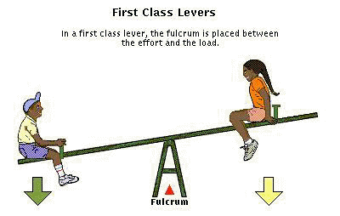

Slide 9
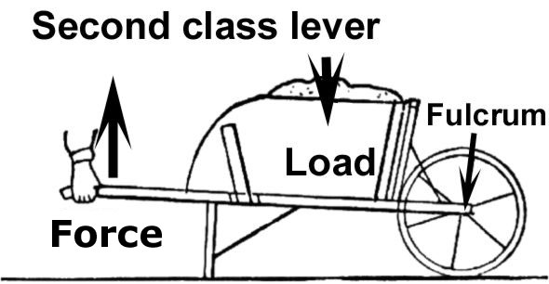

Slide 10
Third Class Lever

Slide 11
Wheel and Axle (p.430)
A wheel and axle is a simple machine that consists of two discs or cylinders, each one with a different radius.
To calculate the ideal mechanical advantage of the wheel and axle, divide the radius (or diameter) where the input force is exerted by the radius (or diameter) where the output force is exerted.
http://video.about.com/autorepair/How-Does-the-Steering-System-Work-.htm

Slide 12
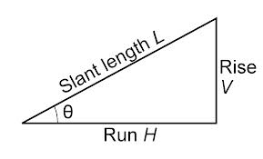
Inclined Planes (p.430)
An inclined plane is a slanted surface along which a force moves an object to a different elevation.
A ramp is an example of an inclined plane.
The ideal mechanical advantage of an inclined plane is the distance along the inclined plane divided by its change in height.

Slide 13
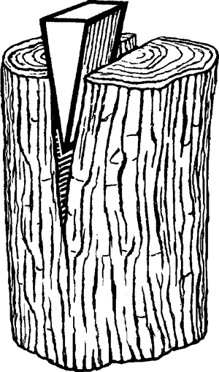
Wedges (p.431)
A wedge is a V-shaped object whose sides are two inclined planes sloped toward each other.
A thin wedge of a given length has a greater ideal mechanical advantage than a thick wedge of the same length.

Slide 14
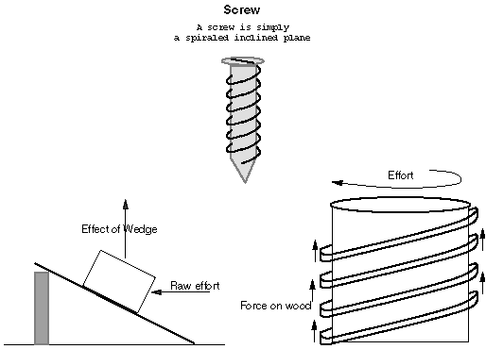
Screws (p.431)
A screw is an inclined plane wrapped around a cylinder.
Screws with threads that are closer together have a far greater mechanical advantage.

Slide 15
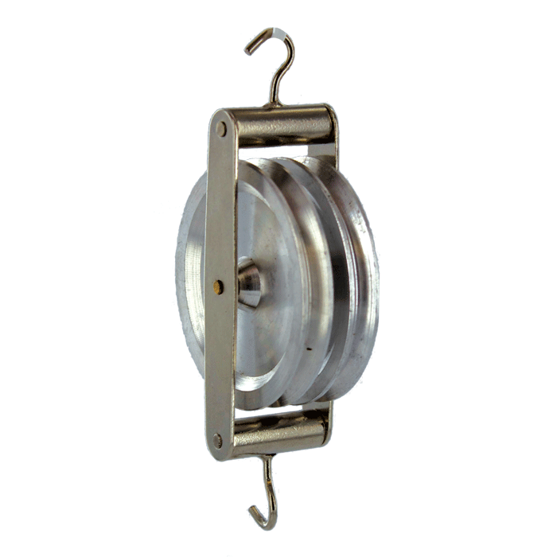
Pulleys (p.432)
A pulley is a simple machine that consists of a rope that fits into a groove in a wheel.
The ideal mechanical advantage of a pulley or pulley system is equal to the number of rope sections supporting the load being lifted.

Slide 16
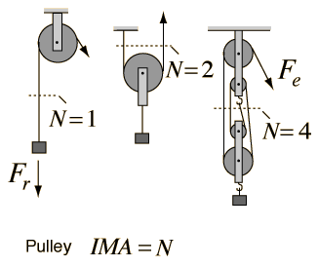

Slide 17
Compound Machines (p.435)
A compound machine is a combination of two or more simple machines that operate together.

Slide 18
Test Simple Machines
Select a simple machine
Design an experiment to test mechanical advantage
Conduct your experiment

Slide 19
Homework
Read 427-435
Questions p. 435 1-9

