Slide 1
Mechanical Advantage and Efficiency
Physical Science

Slide 2
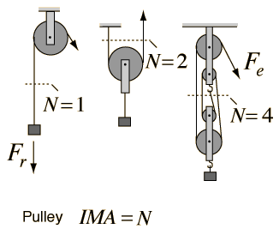
Ideal Mechanical Advantage
The mechanical advantage of a machine is the number of times that the machines increases an input force.
The ideal mechanical advantage (IMA) of a machine is the mechanical advantage in the absence of friction.
Ideal Mechanical Advantage = Input distance/Output distance

Slide 3
Demo problem p. 425
Do practice problems 1-3 p. 425

Slide 4
Friction
Because friction opposes motion, friction reduces the efficiency of a machine. Because friction is always present, the actual mechanical advantage of a machine is always less than the ideal mechanical advantage.

Slide 5
Actual Mechanical Advantage
The mechanical advantage of a machine is the number of times that the machines increases an input force.
The actual mechanical advantage (AMA) equals the ratio of the output force to the input force.
Actual Mechanical Advantage = Output force/Input force

Slide 6
Efficiency
Because there is always some friction, the efficiency of any machine is always less than 100 percent.
Efficiency = Work output/Work Input * 100%
https://www.youtube.com/watch?v=QG3HNQiEaTM

Slide 7
Quick lab Using Friction to Change Mechanical Advantage p. 424

Slide 8
Homework
Read 421-426
Questions p. 426 1-9
Vocab quiz tomorrow

