Slide 1
Physical Science
Ionic Bonding

Slide 2
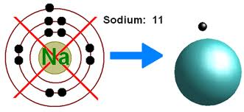
Stable Electron Configurations
When the highest occupied energy level of an atom is filled with electrons, the atom is stable and not likely to react.
Electron dot diagrams – each dot represents a valence electron.

Slide 3
Ionic Bonds
Some elements achieve stable electron configurations through the transfer of electrons between atoms.

Slide 4
Formation of Ions
When an atom gains or loses an electron, the number or protons is no longer equal to the number of electrons.
An ion is an atom with a net positive or negative electric charge.

Slide 5
Anions – are negative ions. Elements that become anions are named –ide.
ex: Chlorine → Chloride
Fluorine → Fluoride
Cations – are positive ions. Elements that become cations are named element ion.
Ex: Sodium → Sodium ion
Barium → Barium ion

Slide 6
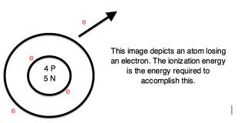
Formation of Ionic Bonds
Ionic bond – force that holds cations and anions together
Ionization energy – the amount of energy required to remove an electron.

Slide 7
Ionic Compounds
Ionic compounds are compounds that contain ionic bonds.
Chemical formula is a notation that shows elements and ratio of those elements

Slide 8
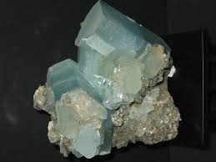
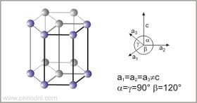
Crystal Lattices
Solids whose particles are arranged in a lattice structure are called crystals.

Slide 9
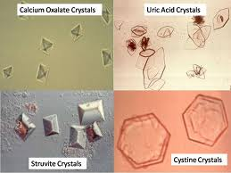

Slide 10
Properties of Ionic Compounds
The properties of ionic compounds can be explained by the strong attractions among ions within a crystal lattice.
The positive and negative charges distribute themselves as evenly as possible.

Slide 11
Classwork
Find at least one example of the following crystal configurations:
Cubic Triclinic
Hexagonal Orthohombic
Tetragonal
Monoclinic

Slide 12
Homework:
Define (from top of page 158):
electron dot diagram
ion
anion
cation
chemical bond
ionic bond
chemical formula
crystals
p. 164 1-8

