Slide 2
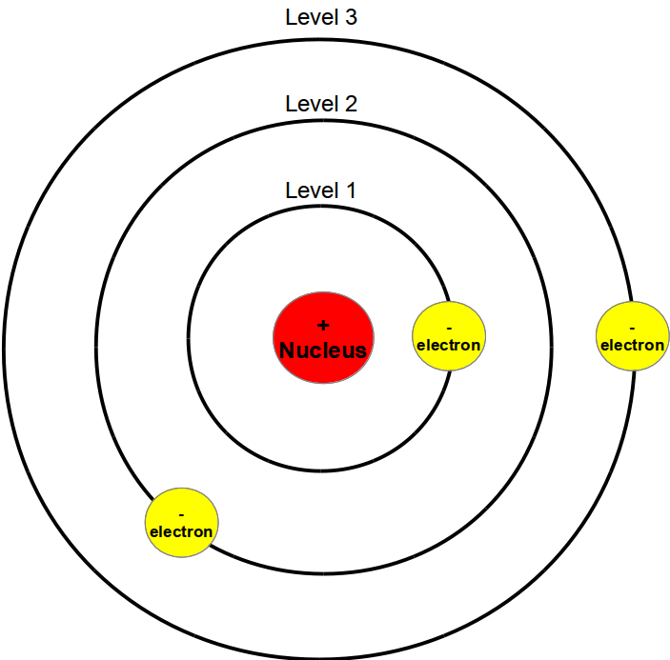
Modern Atomic Theory
Bohr’s Model of the Atom
Possible energies that electrons in an atom can have are energy levels.

Slide 3
Evidence for Energy Levels
Scientists can measure the gain or loss of energy when electrons move between energy levels.
Light is produced by the loss of energy when electrons move from higher to lower energy levels. Because no two elements have the same energy levels, different elements emit different colors of light.

Slide 4
Electron Cloud Model
Schrodinger mathematically described the motion of electrons, which lead to the cloud model.

Slide 5
Atomic Orbitals
An electron cloud is a good approximation of how electrons behave in their orbitals.

Slide 6
Electron Configurations
The most stable electron configuration is the one in which the electrons are in orbitals with the lowest possible energies.
When all electrons have the lowest possible energy, the atom is in ground state

