Slide 1
Mapping

Slide 2
Where in the World is…?
-A global grid was first established after Christopher Columbus proved the world was not flat.
-This grid divides the Earth into degrees.
Latitude and Longitude
-Earth is a sphere, so its circumference is divided into 360 degrees.

Slide 3
Latitude
-Latitude is the distance north or south of the equator and is measured in degrees.
-Lines are parallel and run east to west.
-Climbing a “ladder” when measuring latitude.

Slide 4
Longitude
-Longitude is the distance east to west of the Prime Meridian expressed in degrees.
-Non-parallel lines called meridians that from from the North to South pole.
-0 degrees to 180 degrees E/W

Slide 5
Details
-Details in the grid system are accomplished by dividing the degrees of Latitude and Longitude.
-Degrees are divided into minutes.
-Minutes into seconds.

Slide 6
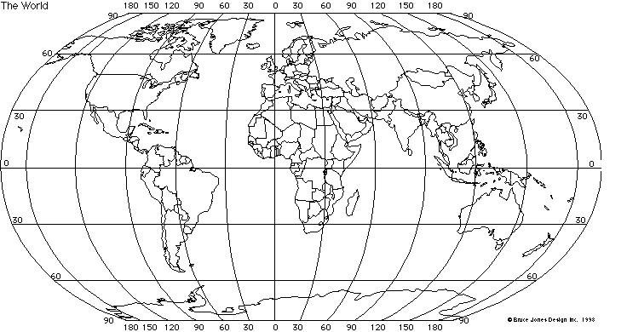
http://mapssite.blogspot.com/2009/10/world-map-with-latitude-and-longitude.html

Slide 7
Practice
Determine the latitude and longitude of…
Southern North Carolina.
Big Island of Hawaii.
Philadelphia.
Notes:
35 N 90 W
18 N 156 W
40 N 75 W

Slide 8
Globes
-3D representations of Earth.
-Models of the Earth.
Lack details, so they aren’t completely accurate.
Show sizes and shapes of continents accurately.
-Mapmakers first used globes because it was hard to make a 2D representation of Earth.

Slide 9
Maps
-Globes would be too large to handle if they included all the small details.
-We use maps to see roads, rivers, and streams.
-Help us get from place to place.

Slide 10
How to make a sphere flat
-Cartographers use map projections to move the image of the Earth’s curved surface onto a flat one.
-Many different projections.
-All map projections have problems, the biggest is distortion.

Slide 11
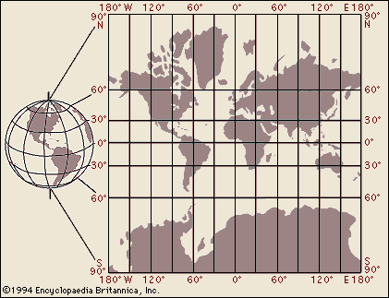
Mercator Projection
-1569
-Latitude and Longitude lines are parallel, making the grid rectangular.
-Directions shown accurately.
-Still used today.
https://www.britannica.com/science/Mercator-projection

Slide 12
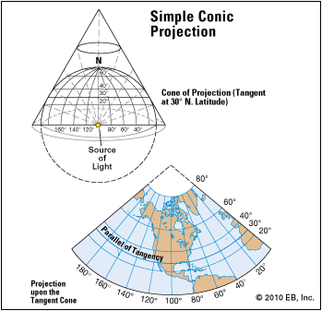
Conic Projection
-There is a little distortion over small areas.
-Made by wrapping a cone of paper around a globe at a particular line of latitude.
-Accurate around 40 degrees latitude.
-Distortions occur North and South of 40 degrees.
https://kids.britannica.com/students/assembly/view/166514

Slide 13
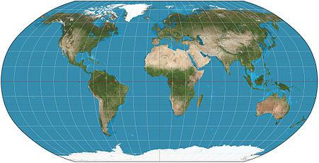
Robinson Projection
-Most widely used.
-Shows distances, sizes, and shapes accurately.
-Distortions are seen around the edges of the map.
https://en.wikipedia.org/wiki/Robinson_projection

Slide 14
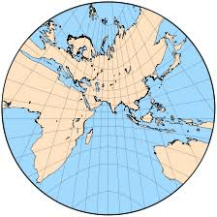
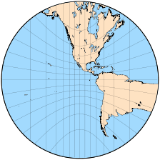
Gnomonic Projection
-Place a piece of paper on the globe’s surface at a single point.
-Various points are projected.
-Shows the shortest distance between two points.
-Areas accurate, shapes distorted.
http://www.progonos.com/furuti/MapProj/Normal/ProjAz/projAz.html

Slide 15
Map Information
-Compass rose
-Title
-Scale
-Legend
-Date

Slide 16
Types of Maps
-Maps represent different parts of the Earth.
-Topographic maps show elevations.
-Road maps represent man-made objects.
-Geologic maps show rocks and minerals.
-Maps are based on modern technologies.

Slide 17
Geologic Maps
-Show the types of rocks and minerals in an area.
-Also show the age of the rocks in the area.
-The ages of the rocks is shown through the use of different colors on the map.
-Often they combine with date from topographic maps.
https://deq.nc.gov/about/divisions/energy-mineral-land-resources/north-carolina-geological-survey/interactive-geologic-maps

Slide 18
Topographic Map
-Show elevations of natural and man-made objects.
-Areas of equal elevation are connected by contour lines.
-Contour lines are closer together on steep inclines, and further apart on flat ground.
-Circles with tick mark represent a depression.
https://www.google.com/maps/place/Danbury,+NC/data=!4m2!3m1!1s0x88525a470e470b2f:0x6125d737ffdf04be!5m1!1e4?sa=X&ved=0ahUKEwiXwbu2zLzYAhWjQ98KHdCDAjAQ8gEIJTAA

Slide 19
Modern Technology
-Technology has changed how we generate and use maps.
-Computers now generate maps.
-Technology has also developed new types of maps.
https://www.mapquest.com/

Slide 20
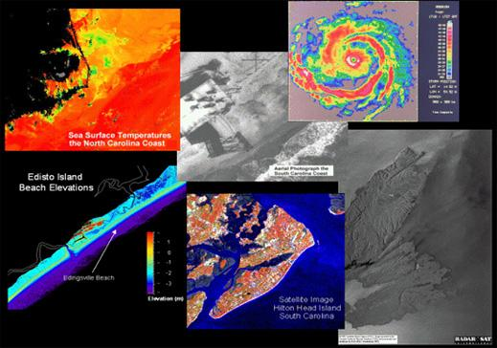
Remote Sensing
-Process of gathering and analyzing information about an object without physically being there.
-Began with the camera.
-Use satellites or radar.
http://geodata.lib.ncsu.edu/fedgov/noaa/commvuln/htm/ccap5.htm

Slide 21
Satellite Imagery
-Uses orbiting satellites to take pictures of Earth from space.
-A part of remote sensing.
https://weather.com/storms/winter/news/2018-01-04-satellite-images-of-winter-storm-grayson

Slide 22
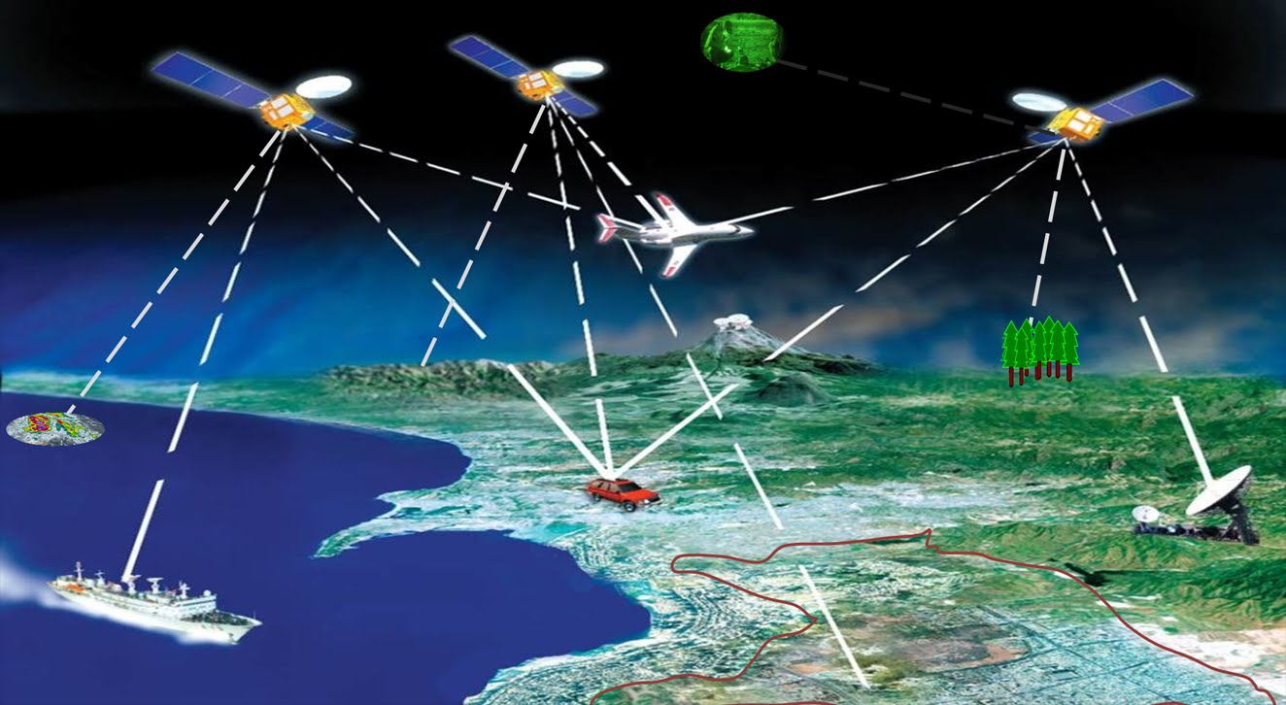
Global Positioning Systems
-A system of orbiting satellites that send radio signals to receivers to calculate a given places, latitude, longitude, and elevation.
-Used in navigation.
-Cartographers use GPS to determine exact boundary lines.
https://www.youtube.com/watch?v=FU_pY2sTwTA

Slide 23
Geographic Information Systems
-A computerized system that allows a user to enter different types of information about an area.
-Used to store, use, and view geographic information.
-Used to make complicated analyses or display maps.
http://maps2.roktech.net/StokesGoMaps4/
https://researchguides.library.wisc.edu/GIS

