Slide 1
Magnetism
Physical Science

Slide 2
Magnets and Magnetic Fields
Magnetic force – the force a magnet exerts.
Magnetic poles – regions where the magnet’s force is strongest.
Magnetic field – surrounds a magnet and exerts magnetic forces.
Magnetosphere – the area surrounding the Earth influenced by its magnetic field

Slide 3
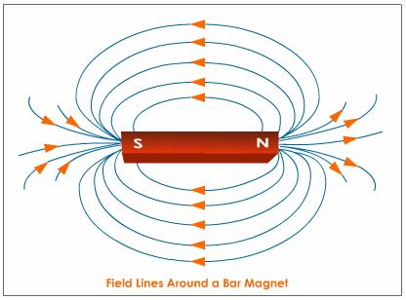

Slide 4
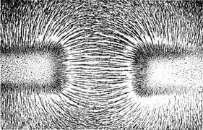
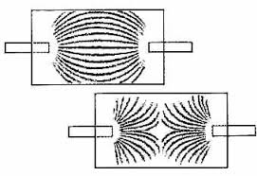
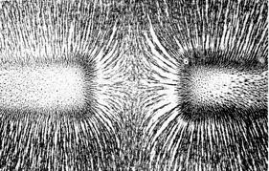

Slide 5
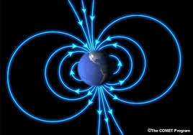

Slide 6
Magnetic Materials
Magnetic domain – a region that has a large number of atoms with aligned magnetic fields.
Nonmagnetized materials – the domains of a ferromagnetic material are aligned randomly.
Magnetized materials – placing ferromagnetic material in a magnetic field aligns the magnetic domains.

Slide 7
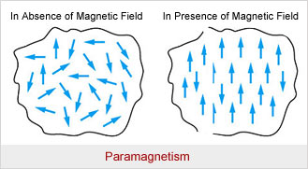

Slide 8
Electricity and Magnetism
Electromagnetic force – a single force from charged particles and movement of electrons.
**Moving electric charges create a magnetic field**

Slide 9
Solenoids and Electromagnets
A coil of current-carrying wire that produces a magnetic field is called a solenoid (the loops act like a bar magnet)
An electromagnet is a solenoid with a ferromagnetic core.
**Changing the current in an electromagnet controls the strength and direction of its magnetic field**

Slide 10
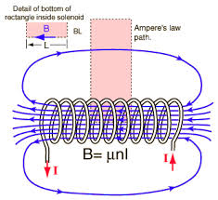

Slide 11
Electromagnetic Devices
**Electromagnetic devices change electrical energy into mechanical energy**
Generators – turn mechanical energy into electrical energy
Motors – turn electrical energy into mechanical energy

Slide 12
Homework
Read 630-639
Questions p.633 1-4, p.639 1-8

