Slide 1
Electric Currents
Physical Science

Slide 2
Circuit Diagrams
An electric circuit is a complete path through which charge can flow.
Circuit diagrams use symbols to represent parts of a circuit.

Slide 3
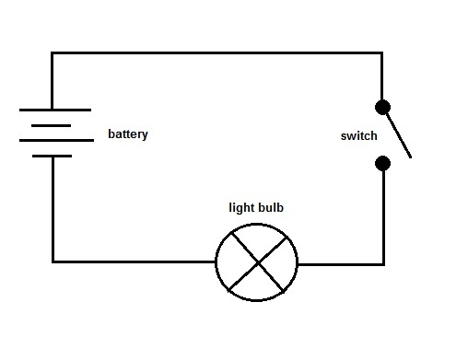

Slide 4
Series Circuits
Charge has only one path.
**if any part stops working, the circuit doesn’t work**
Adding bulbs increases resistance, decreases current, and makes each bulb burn less brightly.

Slide 5
Parallel Circuits
Electric current with two or more paths through which charges can flow.
**If one element stops working, the remaining elements still work**

Slide 6
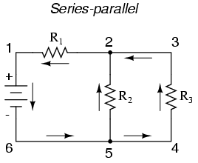

Slide 7
Power and Energy Calculations
Power (watts) = I (amps) X V (volts)
Do math practice 1-3 on p.611
E = P x t

Slide 8
Electrical Safety
Fuse – wire in the center melts if too much current passes through.
Circuit breaker – switch that opens when current is too high.
Insulation – protects from heat and escaping charge (a “short circuit”).
Three-prong plugs – transfer excess charge to Earth.
GFCI – ground fault circuit interrupter – opens circuit if the current in and out of an appliance are not equal.

Slide 9
Homework
Read 609-613
questions 1-8

