Slide 1
Electricity
Physical Science

Slide 2
Electric Charge and Static Electricity
Electric charge – a property that causes subatomic particles such as protons and electrons to attract or repel each other.
Electric charge is produced by an excess or shortage of electrons.
***LIKE CHARGES REPEL,
OPPOSITE CHARGES ATTRACT***
Electric field – the space around the charge where its effect reaches.

Slide 3
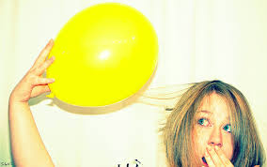
Transfer of Static Charge
Friction – charging by movement

Slide 4
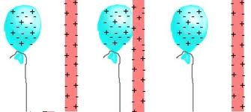
Electrons move from your hair to the balloon. Because your hair loses electrons – it becomes positively charged.
Because the balloon gets electrons – it becomes negatively charged.
The objects build charge through contact!!

Slide 5
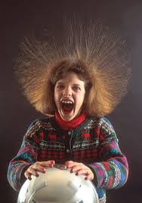
Transfer of Static Charge
Contact – requires touch

Slide 6
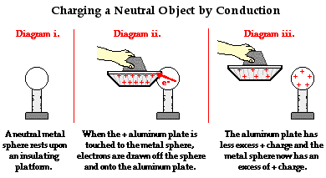
One object has an excess of charge and transfers charge to the other object BY CONTACT!!

Slide 7
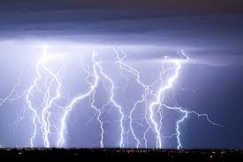
Transfer of Static Charge
Induction – travels through space

Slide 8
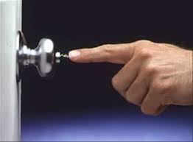
One object has charge and it transfers to the other object WITHOUT contact!!!

Slide 9
Rules of Transfer
ONLY enough charge transfers to relieve the excess.
ONLY electrons can move ---- EVER

Slide 10
Homework
Read 600-603
Questions 1-10

