Slide 1
Chemistry
Scientific Method

Slide 2
Science & Safety
1. Chemistry is the study of ________ and how it changes.
2. Do you need to wear goggles when boiling chemicals in the laboratory?
3. (True/False). The amount of both matter and energy together in the universe never changes.

Slide 3
Science & Safety
(True/False) You can drink a colorless, odorless liquid in the laboratory.
Is physical chemistry an area of chemistry or an area of physics?
(True/False) Chemistry began as the study of Alchemy.
Do you need to wear closed toed shoes to laboratory everyday?

Slide 4
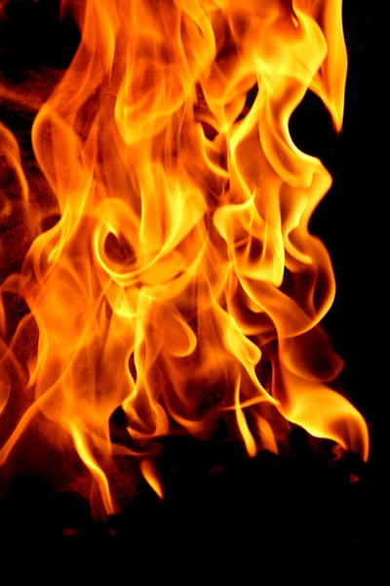
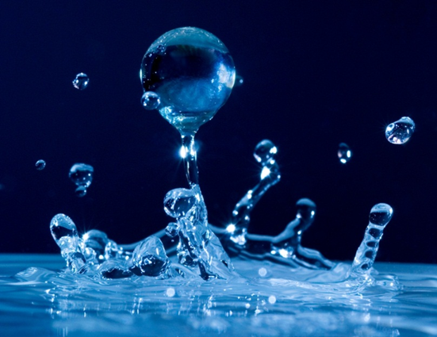
Science & Safety
If then
Is this true or false?

Slide 5
History Connection – In the mid 1700’s, many scientists were still trying to explain materials in terms of combinations of air, earth, fire and water. One French scientist, Antoine Lavoisier, (1743-1794) worked to change the way chemistry was done. Lavoisier had a habit of making very careful measurements in his experiments. One of the things he discovered from these
experiments was that combustion is the result of a reaction with oxygen. Lavoisier also knew that oxygen is needed for life processes. He supposed that when a person was working, the life processes increase and more oxygen would be used. So he set up an experiment to measure the amount of oxygen a person breathed while resting- first on an empty stomach and then after
eating food.

Slide 6
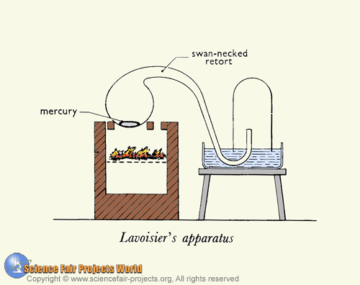

Slide 7
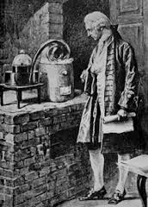
Well, Lavoisier’s measurements did show that more oxygen is
used when food is present. Because of the careful way he set-up and performed his experiment,
Lavoisier is now recognized as the first modern chemist.

Slide 8
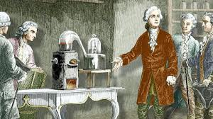

Slide 9
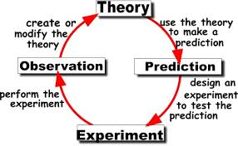
Today, a very systematic, careful way of studying materials is still used by scientists researching anything from creating new materials to examining ways of improving the use or manufacture of existing materials.
So if we want to examine different materials, which you will be doing today in lab, then you need to learn how to apply this systematic process of questioning and testing that scientists use to gather knowledge about materials. If you look at the notes outline, you will see this process is referred to as the Scientific Method.

Slide 10
The Scientific Method
The scientific method is a systematic approach to gather knowledge to answer questions about the world in which we live.

Slide 11
Steps of the Scientific Method:
1. Observations
2. Question
3. Hypothesis, which is a tentative answer to the question. A hypothesis must be testable.
4. Experiment, includes recording and analyzing data gathered.
Each experiment has a variable, the factor being tested and a control.
A control responds in a predictable way to the experiment and is used as a basis or standard for comparison.
5. Conclusion, may lead to new questions, new hypothesis, or new experiments.

Slide 12
After many experiments, scientists may summarize results in a natural law, which is a description of how nature behaves. Scientists may formulate a theory. A theory explains why nature behaves the way described by the natural law. Theories can predict results of further experiments. A law tells us what happened and a theory tells us why.

Slide 13
Science is a way of thinking and acting. A process of inquiry and investigation not just a body of knowledge. This scientific process, the scientific method, is based on the idea that begins with observations. Using the guidelines of the scientific method you and a partner will conduct an investigation to identify the components of an unknown mixture.

Slide 14
Demo Activity
Use this demo to practice recording observations and making hypotheses.
DO NOT write in the first person.
These will be useful on the lab you conduct tomorrow.

Slide 15
Observations
Write YOUR observations on your paper.
What types of observations can we make? (measurement, visual changes, odors …)
What things can we observe during a reaction? (changes in color temperature, fizzing…)
What are some observations we can make about the reaction of vinegar (with some pH
indicator) and baking soda?

Slide 16
Hyposthesis
What hypothesis statement can we make if I double the amount of the vinegar and baking soda?
Can we test this hypothesis?

Slide 17
Prelab: Observing/ Questioning
Maximum of 4 per group.
Group work, INDIVIDUAL write-ups and INDIVIDUAL grades.
Read the ENTIRE lab procedure TWICE.
Decide how you are going to test the substances, and how your are going to set up your results table.

Slide 18
TODAY, you need to turn in:
Quiz/classroom participation sheet
Worksheet
Beginning lab report with the materials, procedure, and your blank data table.
You will do the lab tomorrow. If your beginning lab report is not complete (or done to an acceptable level), you will not participate in the lab.
No open-toed shoes tomorrow and be prepared to tie your hair back.
You will be graded tomorrow in 3 categories:
Safety and proper procedure/chemical handling
Following instructions – if lab was followed EXACTLY
Lab Report

