Slide 1
Chemistry
Scientific Measurement

Slide 2
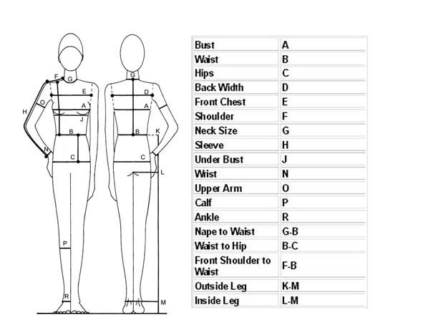
Measurements
A measurement is a quantity that has both a number and a unit.
Measurements are fundamental to the experimental sciences. For that reason, it is important to be able to make measurements and to decide whether a measurement is correct.

Slide 3
Scientific Notation
In scientific notation, a number is written as the product of two numbers: a coefficient and 10 raised to a power.

Slide 4
Accuracy & Precision
Accuracy is a measure of how close a measurement comes to the actual or true value of whatever is measured.
To evaluate the accuracy of a measurement, the measured value must be compared to the correct value.
Precision is a measure of how close a series of measurements are to one another.
To evaluate the precision of a measurement, you must compare the values of two or more repeated measurements

Slide 5
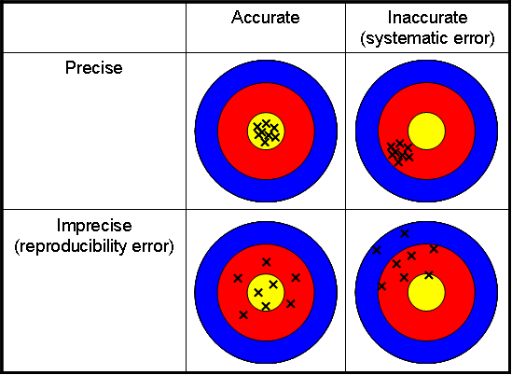

Slide 6
Determining Error
There is a difference between the accepted value, which is the correct value based on reliable references, and the experimental value, the value measured in the lab.
The difference between the accepted value and the experimental value is called the error.
Error = Experimental Value – Accepted Value

Slide 7
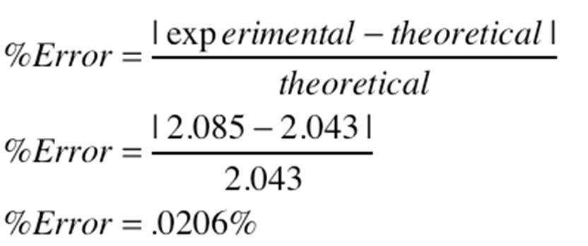
Determining Error
There is a difference between the accepted value, which is the correct value based on reliable references, and the experimental value, the value measured in the lab.
Percent Error = Error/Accepted Value * 100%

Slide 8
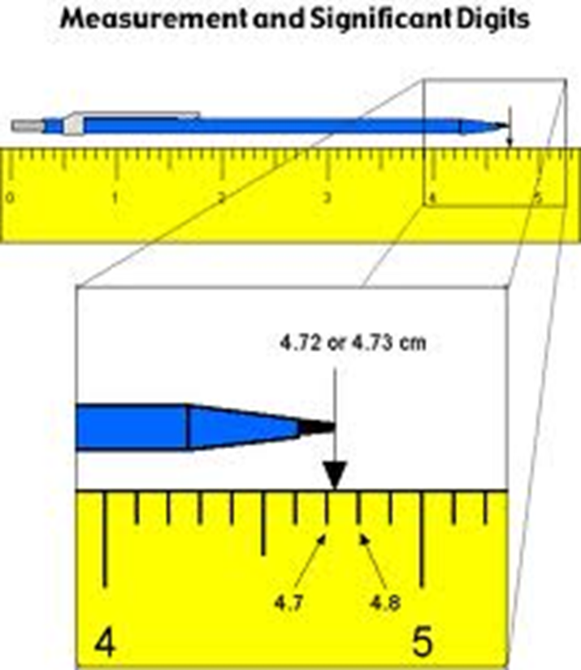
Significant Figures
Significant Figures in a measurement include all of the digits that are know, plus a last digit that is estimated.
Measurements must always be reported to the correct number of significant figures because calculated answers often depend on the number of significant figures in the values used in the calculation.

Slide 9
Turn to page 66-67 and write down the rules for significant figures.

Slide 10
International System of Units
Abbreviated SI
A revised version of the metric system. Adopted by international agreement in 1960.

Slide 11
Units and Quantities
Units of length – meter
Units of volume – liter
Units of mass – kilogram
Units of temperature – Kelvin
absolute zero
converting to Celsius
Units of energy - joule

Slide 12
Measurement Lab
Due Today

