Slide 1
Chemistry January 2
Reaction Rates

Slide 2
Reactions Over Time
Reaction rate is the rate at which reactants change into products over time.
Reaction rate is proportional to the number of effective collisions.

Slide 3
Factors Affecting Reaction Rates
Temperature – increasing temperature increases reaction rates
Surface Area – increasing surface area increases reaction rates
Stirring – stirring increases reaction rates
Concentration – increased concentration increases reaction rates.
Catalysts – catalysts increase reaction rates.

Slide 4
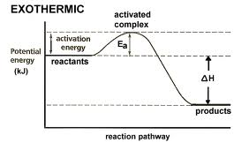
Activation Energy
The minimum energy colliding particles must have in order to react.

Slide 5
Catalysts
Catalysts work by DECREASING ACTIVATION ENERGY.

Slide 6
Equilibrium
When the forward and reverse paths of a change take place at the same rate

Slide 7
Types of Equilibria
Physical equilibrium – when a physical change does not go to completion.
Chemical equilibrium – when a chemical change does not go to completion.

Slide 8
Factors Affecting Chemical Equilibrium
LeChatlier’s Principle – when a change is introduced to a system in equilibrium, the equilibrium shifts in the direction that relieves the change.
Equilibrium means equal rate of formation of products and reactants, NOT an equal amount of product and reactants.

Slide 9
Temperature – if you add heat (endothermic), the equilibrium would shift in the direction that removes heat (exothermic).
Pressure – if you increase pressure, the equilibrium would shift in the direction that decreases pressure.
Concentration – if you increase concentration, the equilibrium would shift in the direction that decreases concentration.

Slide 10
Colligative Properties of Solutions
Solutions have
reduced vapor pressure
higher boiling points
lower freezing points
lower osmotic pressure
than the individual components of solvent and solute.

Slide 11
Titration Curves
Neutral point – where the solution is neutral
Equivalence point – where there is an equal amount of acid and base

Slide 12
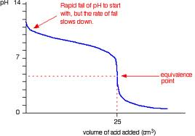
Strong Acid into Strong Base

Slide 13
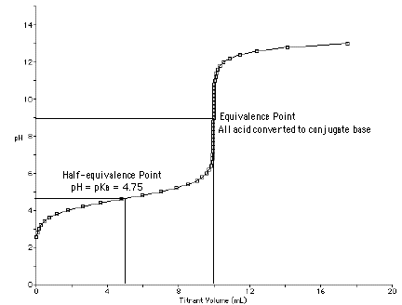
Strong Base into Strong Acid

Slide 14
SciLink Lab
HW: Questions on Final Exam Review:
Explain the factors that affect rate of a reaction
Explain the conditions of a system at equilibrium
Infer the shift in equilibrium.

